Slide 1
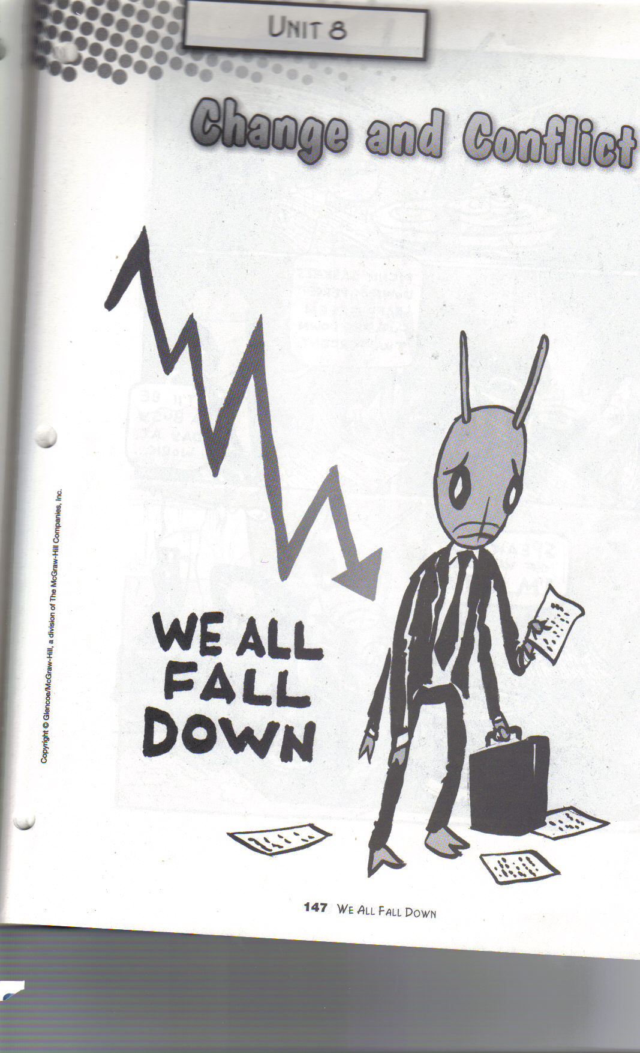
“We All Fall Down”

Slide 2
Click the book to watch one of Aesop’s Fables, “The Ant and the Grasshopper.”

Slide 7
CAST OF CHARACTERS
Mr. Grasshopper
Mr. Mandible

Slide 8
CAST OF CHARACTERS
Mr. Banks
Mr. Antson

Slide 12
