Slide 1
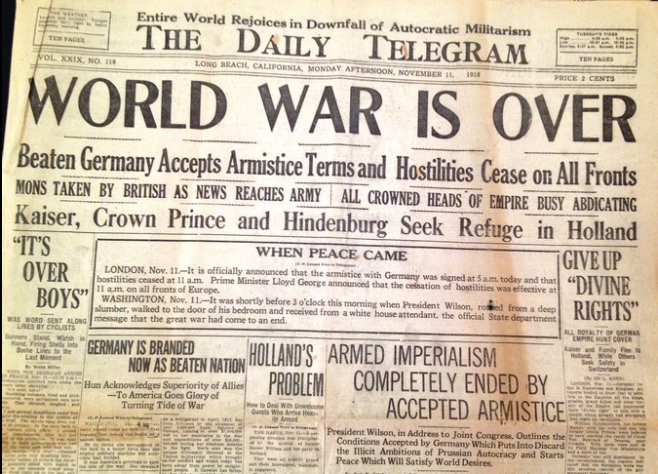
23.5A Academic Marquee Event Challenge Questions

Slide 2
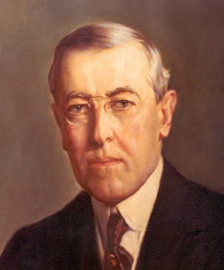
How did President Wilson’s background affect his views on a postwar world?
Question #1
1) President Woodrow Wilson is the only President of the United States that received his “PhD”, meaning he earned a “doctorate”. This means he graduated from high school, college, got his “Master’s Degree”, and then got his “doctorate” degree at John Hopkins University. How might all of this education have influenced his decisions on World War I as President? How might he look at problems and how to solve problems differently than a person who did not attend so much schooling in their lifetime?

Slide 3
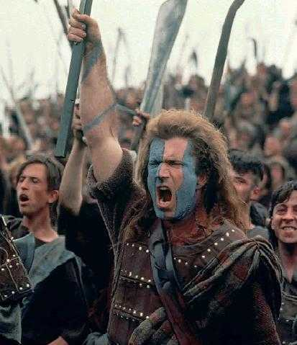
What kind of country would you prefer to live in?
Question #2
2) The following is a quote from President Wilson…. “I would rather belong to a poor nation that was free than to a rich nation that had ceased to be in love with liberty. But we shall not be poor if we love liberty, because the nation that loves liberty truly sets every man free to do his best and be his best, and that means the release of all the splendid energies of a great people who think for themselves.” Do you agree with Wilson or disagree… Would you rather live in a poor, free country or a rich, controlled country? Explain your answer.

Slide 4
What did President Wilson mean by a “peace without victory?”
Question #3
3) The following is a quote from President Wilson from January 22, 1917 (which was almost two years before the end of the war and three months before the United States even entered the war)… “It must be a peace without victory... Victory would mean peace forced upon the loser, a victor's terms imposed upon the vanquished. It would be accepted in humiliation, under duress, at an intolerable sacrifice, and would leave a sting, a resentment, a bitter memory upon which terms of peace would rest, not permanently, but only as upon quicksand. Only a peace between equals can last.” List the two main ideas of what President Wilson was trying to accomplish with this quote.

Slide 5
What would be some of the problems Europe had to figure out after World War I was over?
Question #4
4) Wars are destructive. World War I was very destructive. Discuss some of the problems that Europe would need to figure out now that the war was over. What goals would the leaders need to set to move forward? What measures would the European countries need to take to prevent another world war from breaking out in the future?

Slide 6
Who should pay for all of the damages of World War I?
Question #5
4) Wars are destructive. World War I was very destructive. Properties, buildings, land, and lives were destroyed and damaged. Which country or countries should have to pay “reparations” (cash payments to repair the damage that had been done)? Explain why you believe that country or those countries should be financially responsible.

Slide 7
Do you prefer your President to be an “idealist” or a “realist?”
Question #6
5) President Wilson’s views on how countries should get along have been called “Wilsonian idealism”. He believed the world would be a better place if the world followed basic, international laws and international organizations would be the main force in keeping world peace. In the “Wilsonian idealism”, mankind is viewed as generally good-natured. The opposite view of “Wilsonian idealism” is the concept of “realism” which states that countries act on their own national interest. In their national interest, the countries try to get resources so they can be safe and survive. In this view, realists believe mankind is self-centered and competitive. After looking at these two different viewpoints, explain which type of President you would rather have leading our country…. A Wilsonian idealist or a realist?

Slide 8
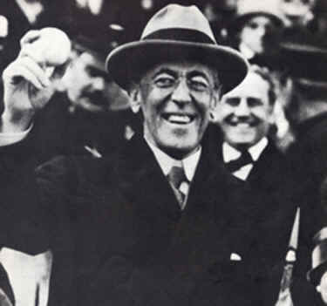
How might President Wilson have misjudged the cheers he received in Europe as support for his “peace without victory” idea?
Question #7
6) President Wilson was the first acting President to visit Europe while he was still President. When he arrived, he was cheered and welcomed wherever he went. The first question is this… Why were so many of these Europeans excited to see President Wilson? The second question is this….. How might this admiration influence President Wilson’s feelings about how Europe might accept his “Fourteen Points” plan for a post-war world?

Slide 9
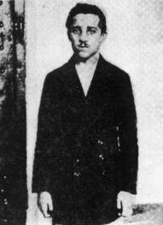
Could your words change history?
Question #8
7) If a time machine was invented, and you could go back in time and talk to Gavrilo Princip on the morning of June 28, 1914 (the day of the assassination,) write a speech that you would give to Gavrilo in which you would try to convince him not to assassinate the Archduke. Think about the facts you could present him with that would try to get him to think about the consequences of his actions.

