Slide 1
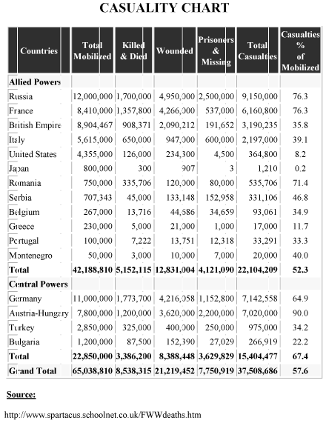
A

Slide 2
B
Treaty of Versailles:
General Penalties
The following general penalties were placed on Germany.
01) Germany had to admit full responsibility for starting the war. This was “Clause 231”: the “War Guilt Clause”.
02) Germany’s land size was reduced by 12.5%.
03) Germany’s population (from redrawing their boundary) was decreased by 6,500,000 people.
04) Germany lost 16.7% of its farmland.
05) Germany lost 12.5% of its livestock.
06) Germany lost 10% of its factories.

Slide 3
C
Treaty of Versailles:
Territorial Penalties
The following lands were taken away from Germany.
Area Taken Away | Area Given To
Alsace-Lorraine | France
Eupen & Malmedy | Belgium
Northern Schleswig | Denmark
Hultschin | Czechoslovakia
West Prussia, Posen, & Upper Silesia | Poland
The Saar, Danzig, & Memel | They were put under the control of the League of Nations and the people of these regions would be allowed to vote to stay in Germany or not in a future vote.
Germany’s overseas colonies | The League of Nations
Lands received in the Treaty of Brest-Litovsk | Germany had to return to Russia land taken in the Treaty of Brest-Litovsk. Some of this land was made into new states: Estonia, Lithuania, and Latvia. An enlarged Poland also received some of the land.

Slide 4
D
Treaty of Versailles:
Military Penalties
The following penalties were placed on Germany’s military.
01) Germany’s army was reduced to 100,000 men.
02) The army was not allowed tanks, heavy artillery, or poison-gas supplies.
03) Germany was forbidden from allowing a military air force.
04) Germany was only allowed six battleships.
05) Germany was forbidden from having submarines.
06) The west of the Rhineland and 50 kilometers east of the Rhine River was made into a demilitarized zone (DMZ). No German soldier or weapon was allowed in this zone. The Allies were to keep an army of occupation on the west bank of the Rhine for 15 years.

Slide 5
E
Treaty of Versailles:
Financial Penalties
The following penalties were placed on Germany’s economy.
01) Germany was also forbidden to unite with Austria to form one superstate, in an attempt to keep its economic potential to a minimum.
02) Germany, as it was responsible for starting the war, as stated in “Clause 231”, was, therefore, responsible for all the war damage caused by the First World War. Therefore, it had to pay reparations, the bulk of which would go to France and Belgium to pay for the damage done to the infrastructure of both countries by the war. Quite literally, reparations would be used to pay for the damage to be repaired.
03) Payment could be in cash. The figure was not set at Versailles – it was to be determined later. The Germans were told to write a blank check which the Allies would cash when it suited them. The figure was eventually put at 269 billion gold marks (300 billion dollars). This was a huge sum of money beyond Germany’s ability to pay.
04) The loss of vital industrial territory would be a severe blow to any attempts by Germany to rebuild its economy. Coal from the Saar and Upper Silesia, in particular, was a vital economic loss.

Slide 6
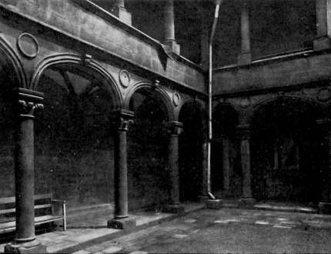
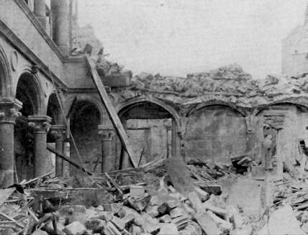
The Cloister of the Hotel de la Princerie in Verdun, France
F
Before World War I
After World War I

Slide 7
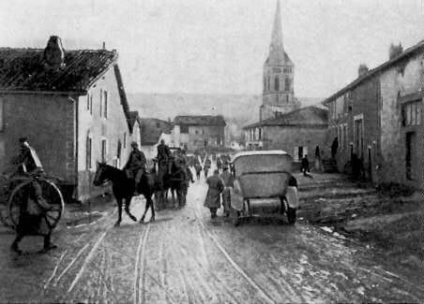
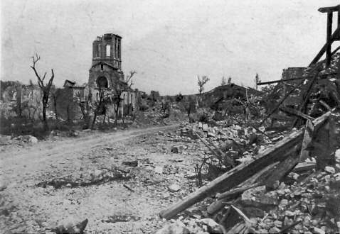
Village of Esnes, France
G
Before World War I
After World War I

Slide 8
H
I

Slide 9
J
The German Reply to the Treaty of Versailles
To His Excellency Mr. Clemenceau:
In accordance with my communication of May 9th of this year, I have the honor to present to your Excellency the report of the Economic Commission charged with the study of the effect of the Peace Terms on the situation of the German population.
During the last two generations, Germany has been transformed from an agricultural state to an industrial state. While an agricultural state, Germany could nourish forty-million inhabitants.
As an industrial State, it can assure the nourishment of a population of sixty-seven million. In 1913, the importation of goods amounted in round figures to twelve million tons. Before the war, a total of fifteen million persons found an existence in Germany of foreign commerce and navigation, either directly, or indirectly, by using our raw materials.
Moreover, Germany must renounce her Colonies; all her foreign possessions, all her rights and interests in the Allied and Associated countries, in their Colonies, Dominions or Protectorates are to be liquidated and credited to the payment of reparations, and are to be submitted to any other step of economic warfare that the Allied and Associated Powers may see fit to maintain or to take during the years of peace.
When the territorial clauses of the Peace Treaty go into effect Germany will lose in the East the most important regions for the production of wheat and potatoes, and this would be the equivalent to a loss of twenty-one percent of the total harvest of these foodstuffs.
Moreover, the intensiveness of our agricultural production would be greatly decreased. On the one hand, the importation of certain raw materials indispensible for the production of fertilizer, such as phosphates, would be hampered; on the other hand, this industry would like all other industries suffer from the shortage of coal.
For the Peace Treaty provides for the loss of almost a third of the production of our coal fields; in addition to that loss, enormous deliveries of coal to various Allied countries are imposed on us for ten years.

Slide 10
K
Hitler’s Speech On The Treaty Of Versailles (April 17, 1923)
With the armistice begins the humiliation of Germany. If the Republic on the day of its foundation had appealed to the country: Germans, stand together! Up and resist the foe! The Fatherland, the Republic expects of you that you fight to your last breath, then millions who are now enemies of the Republic would be fanatical Republicans. Today they are the foes of the Republic not because it is a Republic but because this Republic was founded at the moment when Germany was humiliated, because it so discredited the new flag that men’s eyes must turn regretfully toward the old flag.
So long as this Treaty stands there can be no resurrection of the German people; no social reform of any kind is possible! The Treaty was made in order to bring 20 million Germans to their death and to ruin the German nation. But those who made the Treaty cannot set it aside. As its foundation our Movement formulated three demands:
1. Setting aside of the Peace Treaty.
2. Unification of all Germans.
3. Land and soil [Grund und Boden]
Our movement could formulate these demands, since it was not our Movement which caused the War, it has not made the Republic, it did not sign the Peace Treaty.
There is thus one more thing which is the first task of this Movement: it desires to make the German once more National, that his Fatherland shall stand for him above everything else. It desires to teach our people to understand afresh the truth of the old saying: He who will not be a hammer must be an anvil. An anvil we are today, and that anvil will be beaten until out of the anvil we fashion once more a hammer, a German sword!

Slide 11
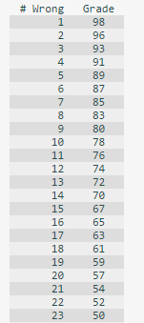
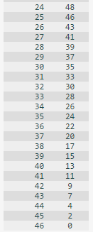
Ws 23.5C grading scale

