Slide 1
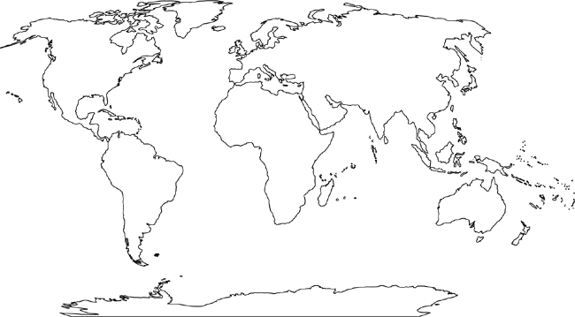
CHAPTER 24 GEOGRAPHY MAP
H
E
A
I
C
J
L
D
B
K
F
M
G
You need to know the following continents & major bodies of water
Africa | Arctic Ocean | Atlantic Ocean | Europe | Mediterranean Sea | Pacific Ocean | Southern Ocean
Antarctica | Asia | Australia | Indian Ocean | North America | South America

