Slide 1
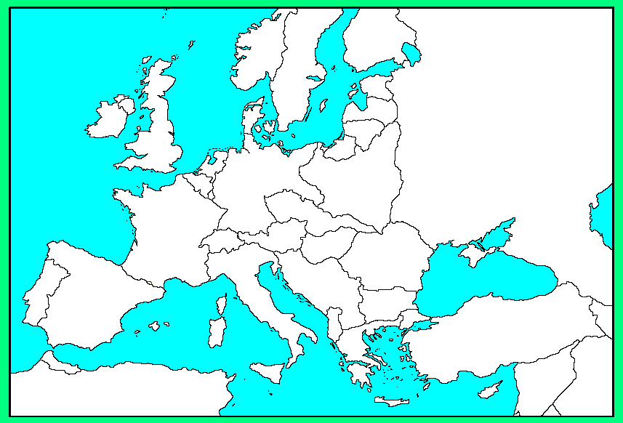
CHAPTER 26 EUROPE MAP: WORLD WAR II
Albania
Atlantic Ocean
Austria
Belgium
Berlin
Czechoslovakia
Denmark
Dunkirk
English Channel
Estonia
Finland
France
Germany
Great Britain
Ireland
Italy
Latvia
Leningrad
Lithuania
London
Maginot Line
Mediterranean Sea
Moscow
The Netherlands
Normandy
Norway
Paris
Pas-de-Calais
Poland
Rhineland
Rome
Sicily
Soviet Union
Stalingrad
Sudetenland
Switzerland

Slide 2
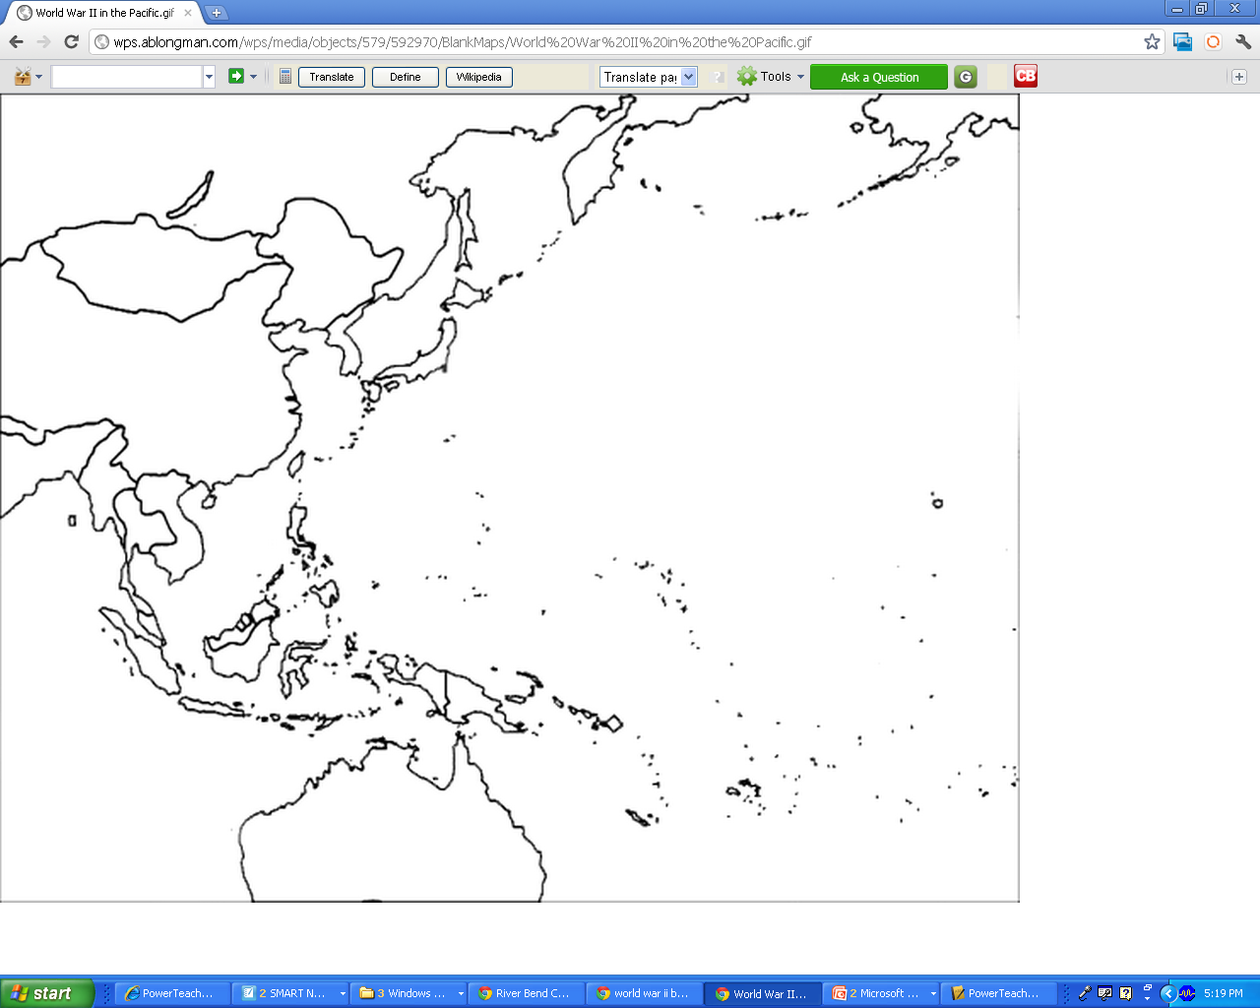
CHAPTER 26 ASIA MAP: WORLD WAR II
Australia
China
French Indochina
Hiroshima
Japan
Manchuria
Nagasaki
Pacific Ocean
Pearl Harbor
The Philippines
Tokyo
Soviet Union

