Slide 1
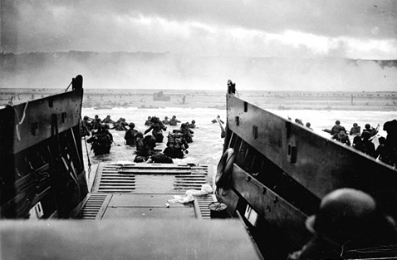
PP 26.4C: “D-Day”
Page 823

Slide 2
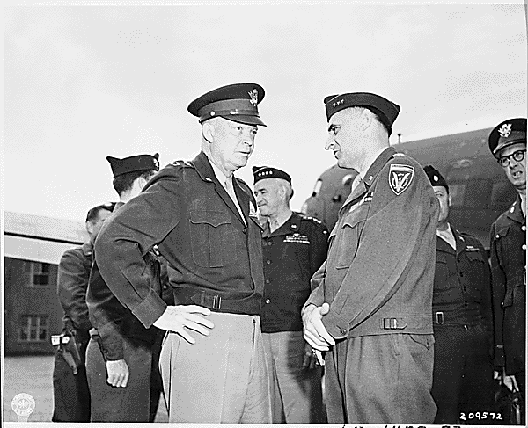
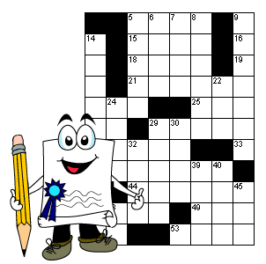
Click on the crossword puzzle to read a story on how the code names of Operation Overlord were curiously found in The Daily Telegraph, a newspaper at the time.
http://www.historic-uk.com/HistoryUK/HistoryofBritain/Crossword-Panic-of-1944/

Slide 3
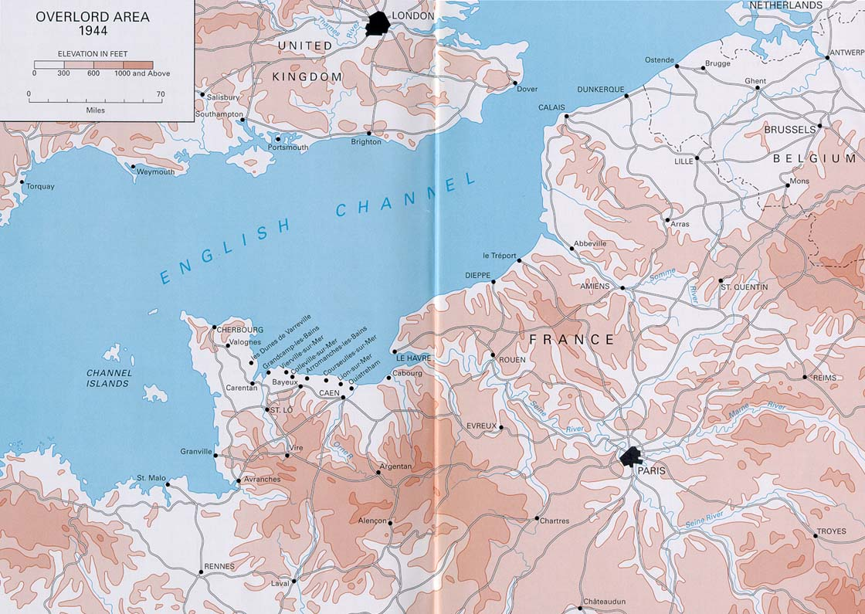
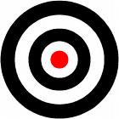
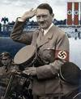
Pas de Calais
von Rundstedt
Normandy
Rommel

Slide 4
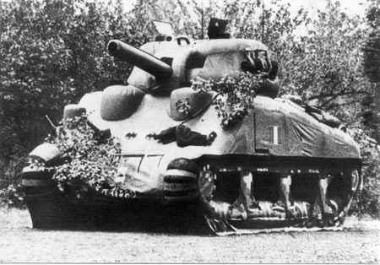
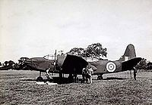
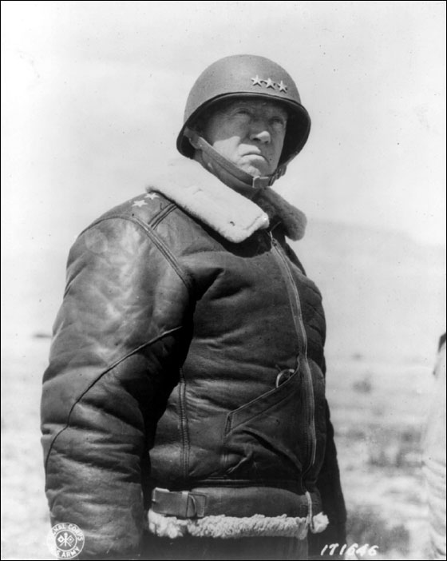
Operation fortitude
“Operation Fortitude” was the codename for the Allied attempt at getting the Germans to believe the invasion of France was going to occur: either in Norway (“Fortitude North”) or at Pas de Calais (“Fortitude South.”)
Fake equipment, such as inflatable rubber tanks, plywood artillery, and dummy planes were constructed and placed in areas to misdirect the Germans.
Fake information was “leaked.”
The Allies used double agents to send false information to the Germans.
The FUSAG (First United States Army Group) was invented and “placed” in Dover. General George Patton was given “command” of this group.
“Operation Fortitude” was a huge success. Based on information gathered from breaking the German’s Enigma code, the Germans bought into the fake. Even when the Allies were invading Normandy, the Germans thought the invasion of Normandy was a fake for the “real invasion” at Pas de Calais.

Slide 5
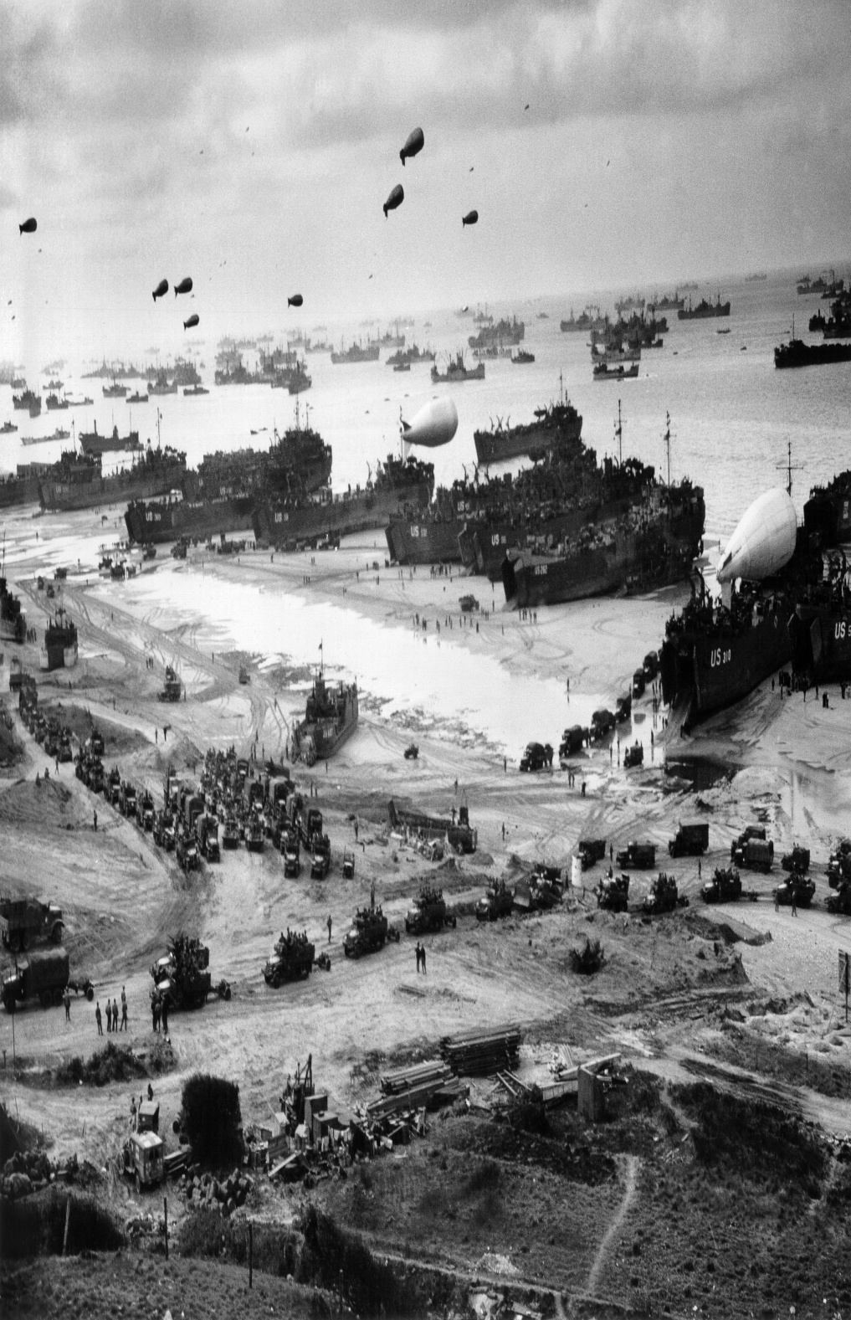
June 6, 1944
The largest amphibious (sea borne) invasion in human history.
The “D” in “D-Day” doesn’t really stand for anything.
On “D-Day,” over 175,000 troops were dropped off from over 5,000 ships.
Eventually, almost 3 million soldiers crossed the English Channel from England to Normandy Beach.

Slide 6
Great success
Bloody Omaha
Good success

Slide 8
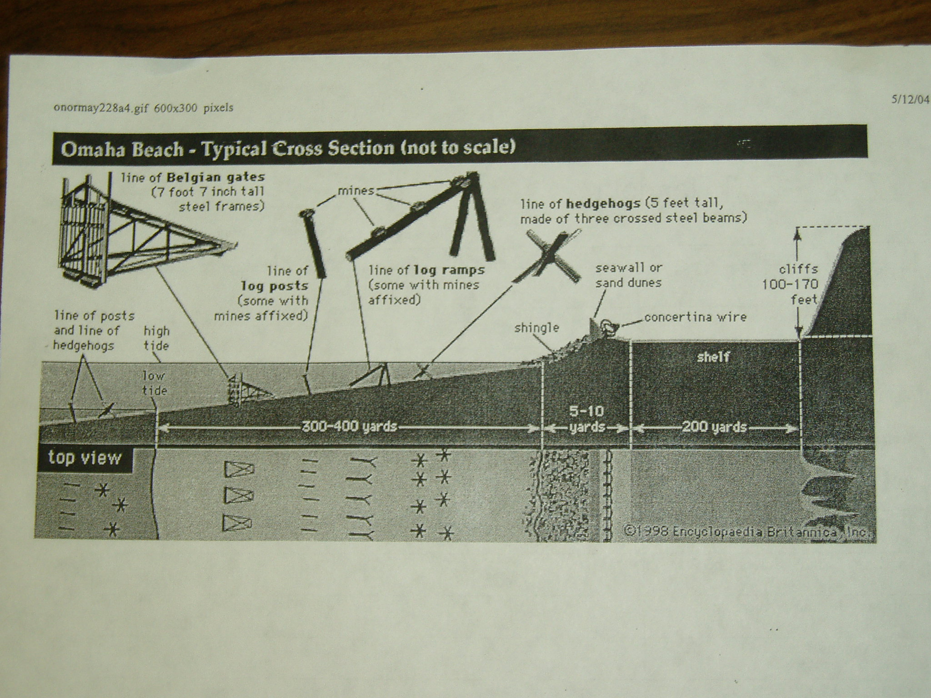

Slide 10
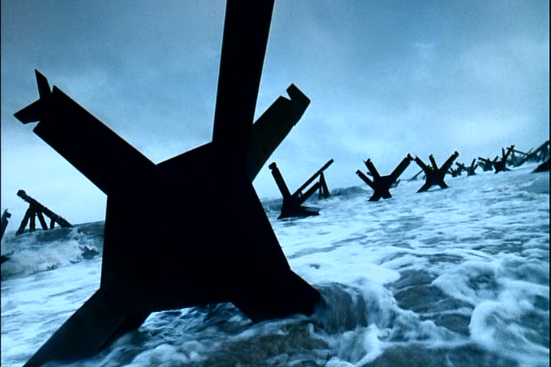
Czech Hedgehogs

Slide 11
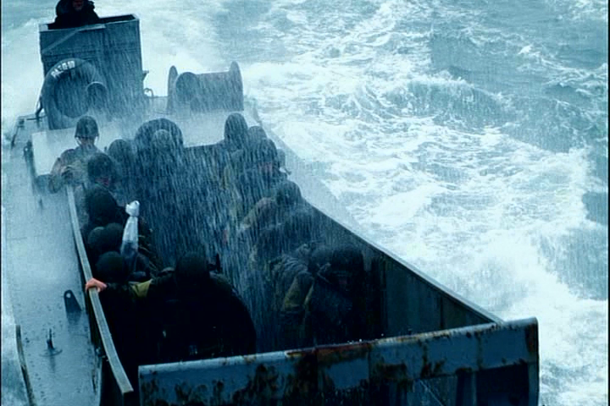
Higgins Boat
The Higgins Boat, a Louisiana-built landing craft, was crucial in winning the war. These boats were 30 feet long and only eight feet wide, resembling a cigar box, but were strong enough to carry 32 soldiers. Andrew Jackson Higgins’ boats were used during the invasion at Omaha Beach, because they were effective in getting onto the open beach through Louisiana's shallow bayous. Higgins built more than 12,000 boats for Europe and the Pacific with the help of 20,000 workers. The Higgins Boats used at the Omaha Beach invasion made winning World War II possible.

Slide 12
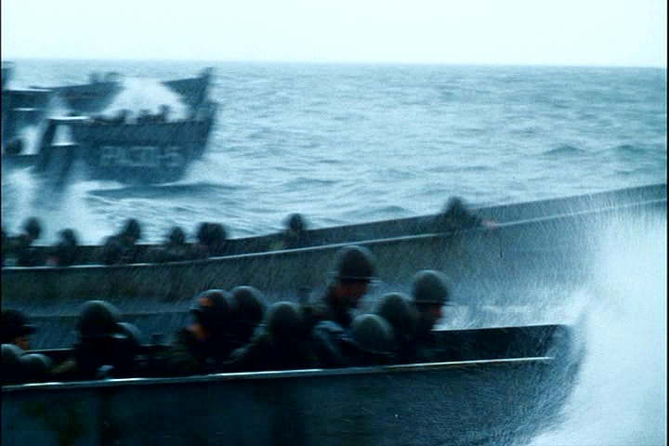
Notice the choppy, stormy waters
of the English Channel

Slide 13
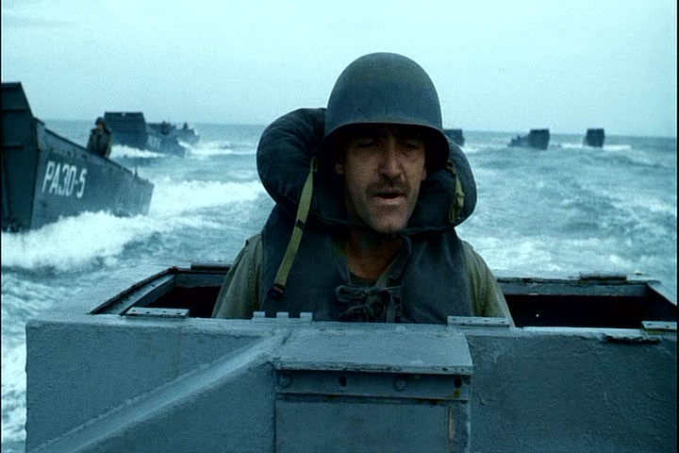

Slide 14
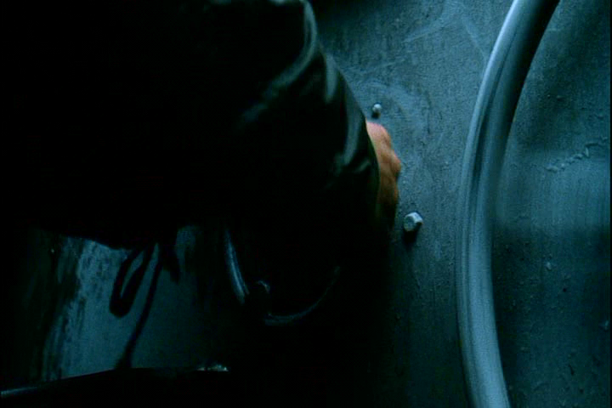
The door to the Higgins boat

Slide 15
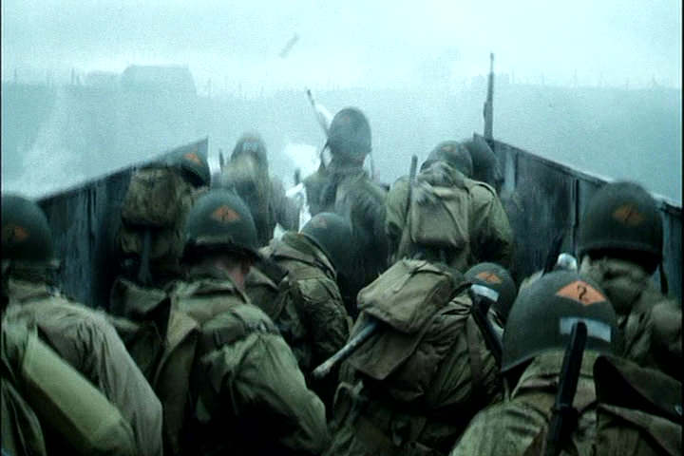
View as the door to the Higgins boat opens

Slide 16
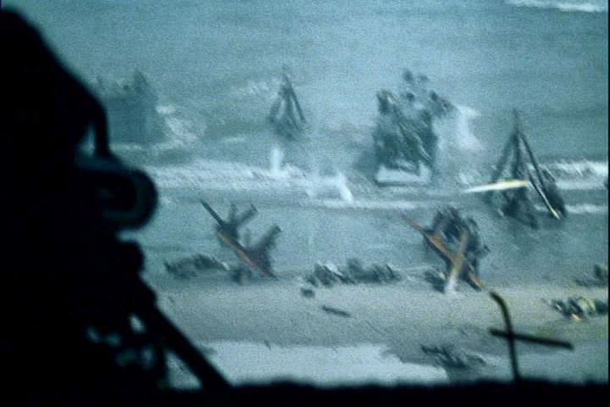
View of the German
machine gunner(s) as Allied soldiers landed

Slide 17
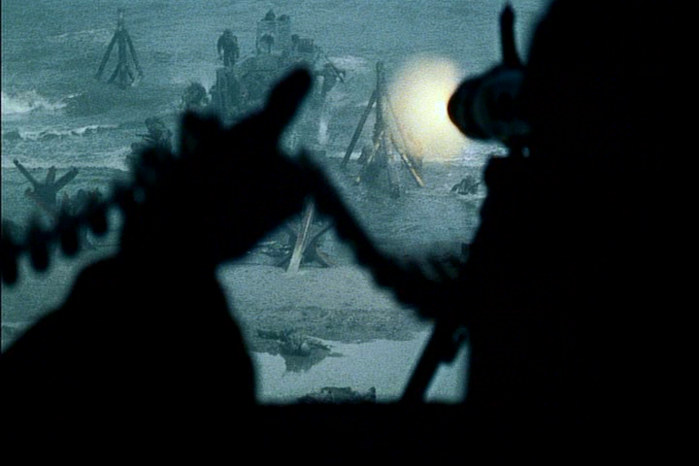
View of the German
machine gunner(s) as Allied soldiers landed

Slide 18
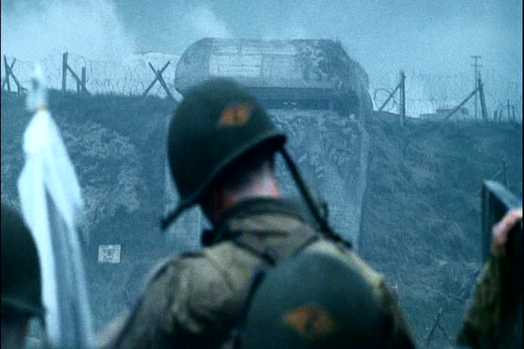
View of the Allied soldier

Slide 19
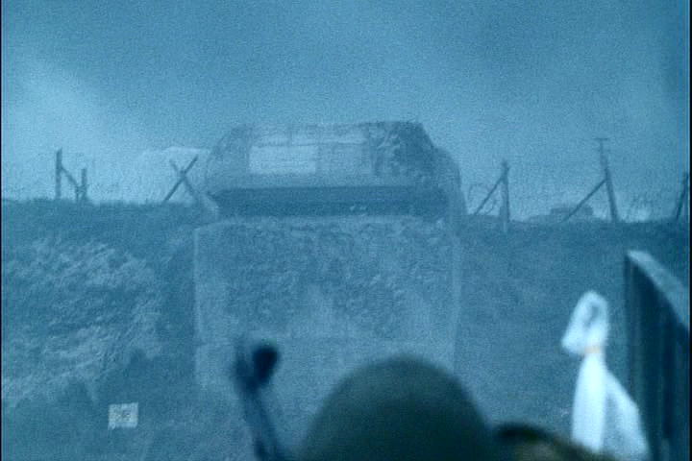
View of the Allied soldier

Slide 20
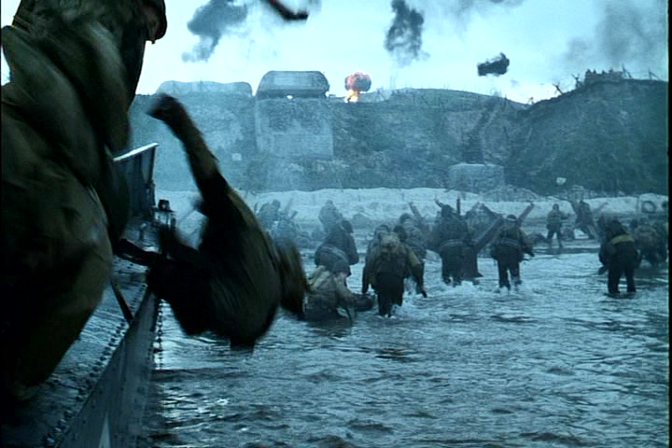
Notice Allied soldiers
going through water
(no firing of weapons)

Slide 21
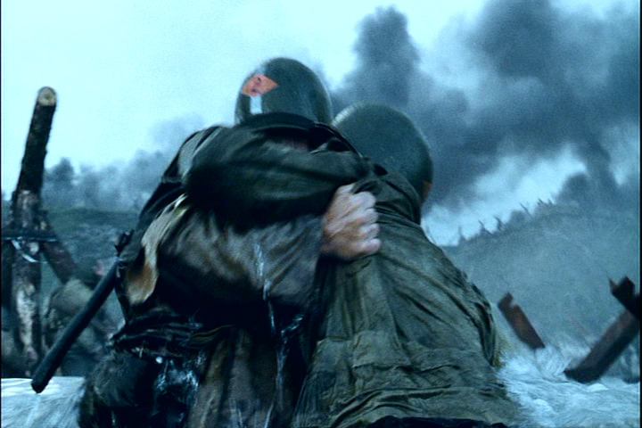

Slide 22
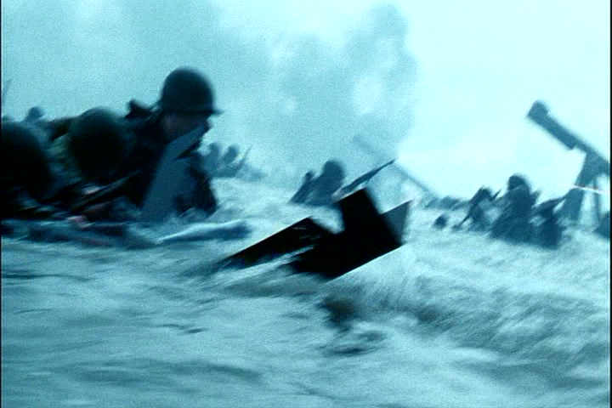

Slide 23
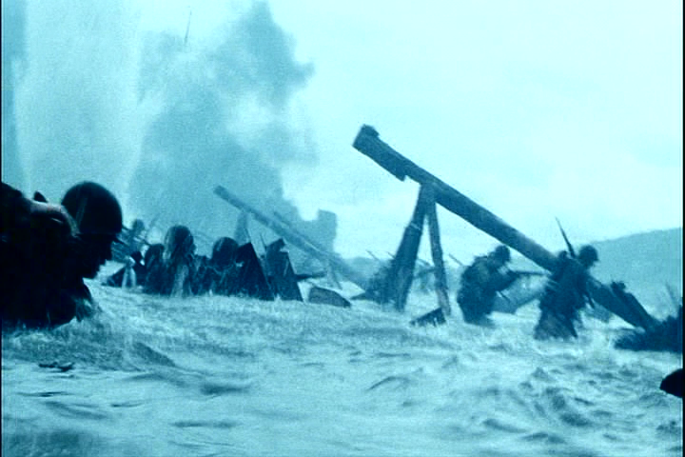
“Wrong-way poles”: In the Omaha Beach scene some of the obstacles are pointed in the wrong direction. These wooden obstacles consisted of a log roughly the size of a telephone pole with one end elevated and supported by two other logs. The raised end was supposed to face the beach. The idea was that an incoming landing craft would ride up the pole and detonate the Teller mine at the end of it. Yet in the opening beach scene, the elevated end of these poles is facing the water. Later during the Omaha Beach sequence the poles have reversed direction and are facing the proper way.
Notice how the log ramps are
facing the wrong way

Slide 24
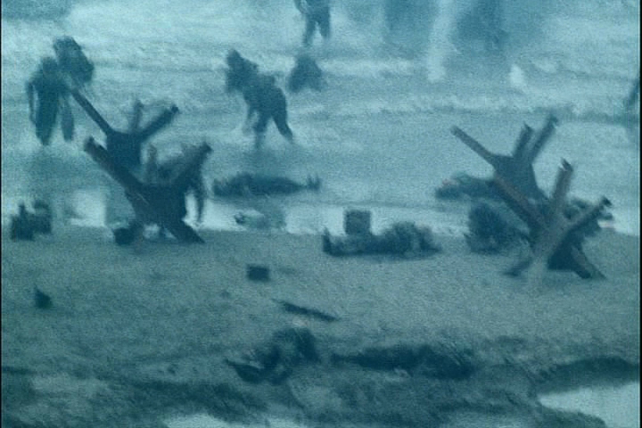
Allied soldiers trying
to get on the beach

Slide 25
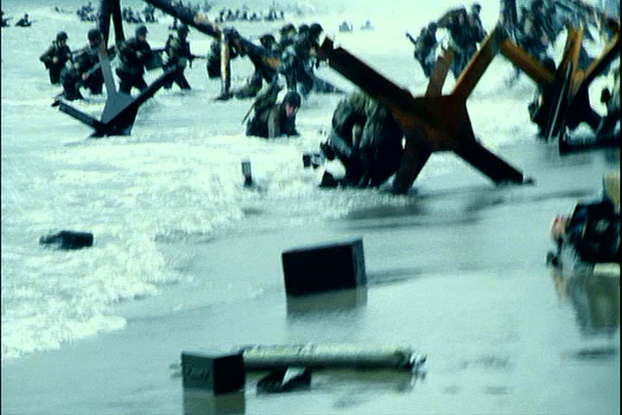
Allied soldiers trying
to get on the beach

Slide 26
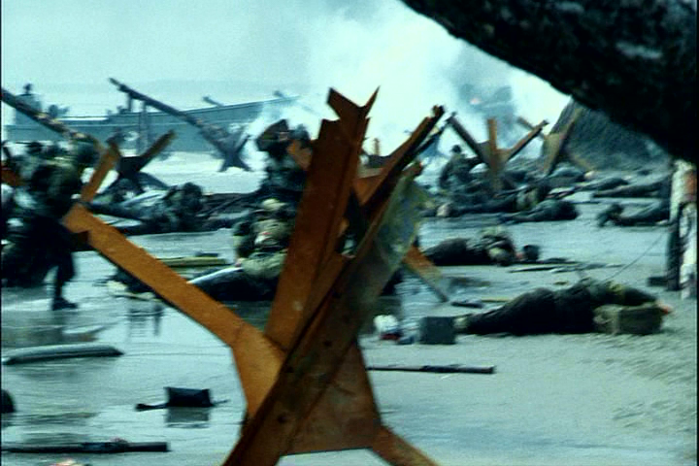
Organized Chaos

Slide 27
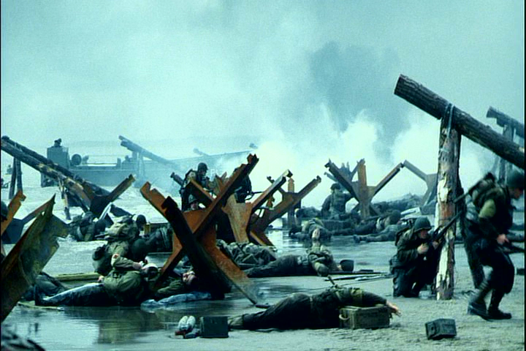
Organized Chaos

Slide 28
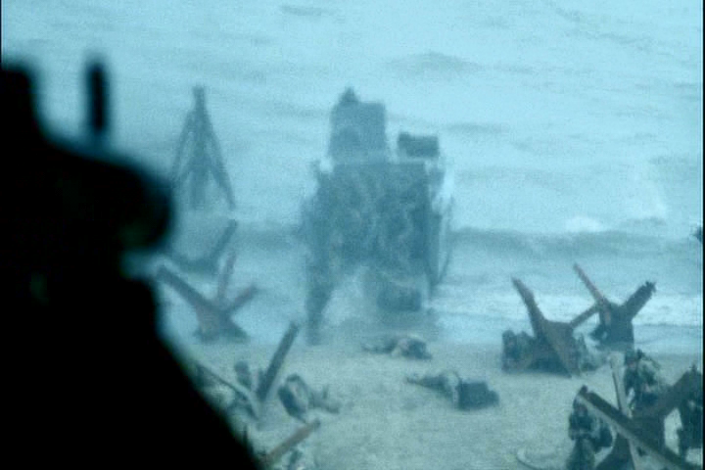

Slide 29
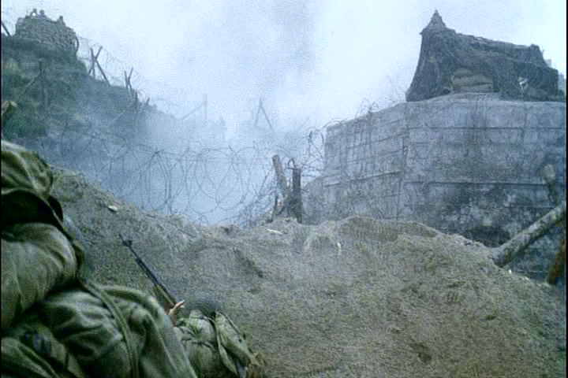
Concertina Wire

Slide 30
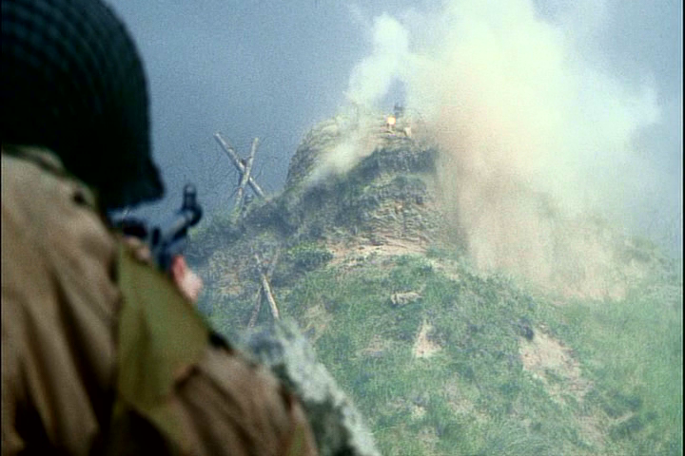
German Machine Gun Nest

Slide 31
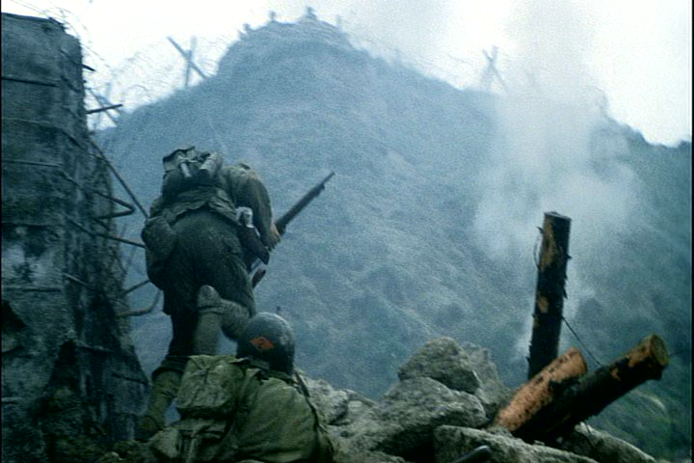
German Machine Gun Nest

Slide 32
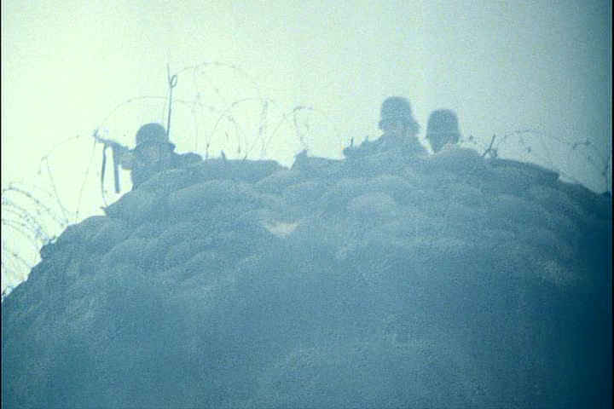
German Machine Gun Nest

Slide 33
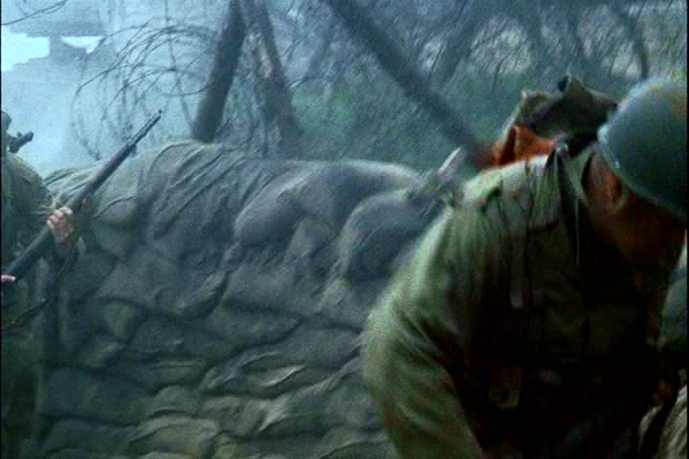

Slide 34
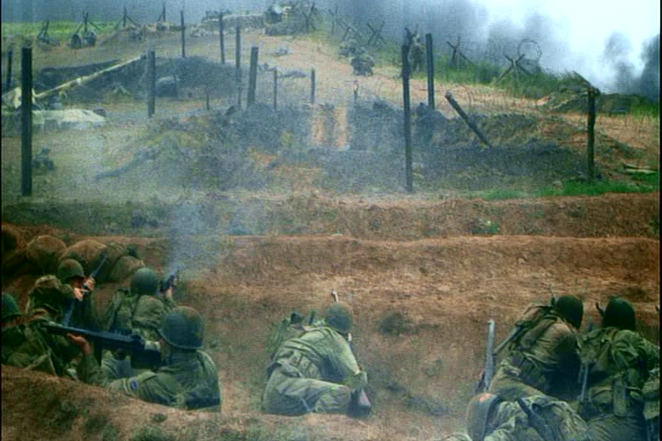

Slide 35
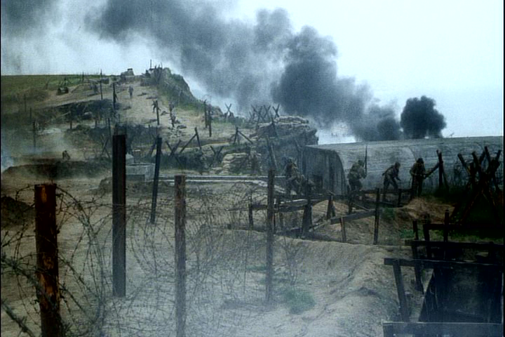

Slide 36
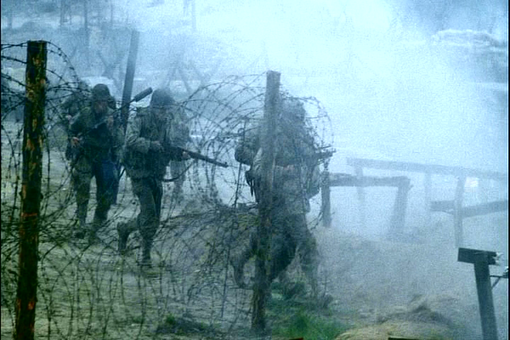
Concertina Wire

Slide 37
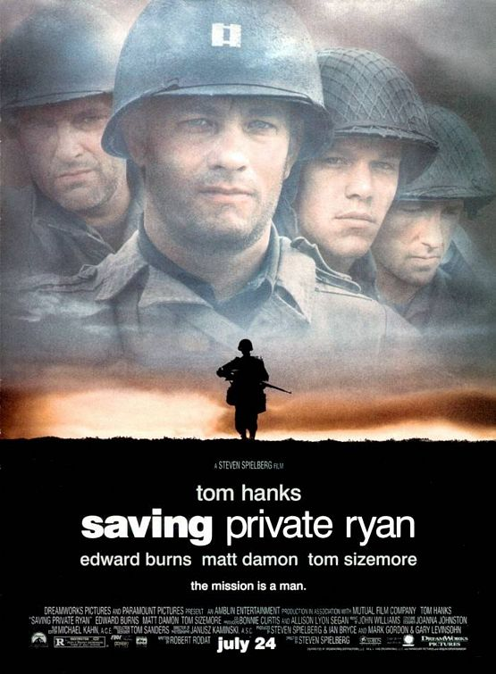
Click on the picture to watch a clip of “Saving Private Ryan.”

