Slide 1
A

Slide 2
B

Slide 3
C

Slide 4
D

Slide 5
E

Slide 6
F
Getting A Taste Of It
How’s I know how that was gonna taste?
I don’t like any of these dishes!
Its’ not so bad…
I want more!
I ain’t gonna touch it… even if it does smell good…

Slide 7
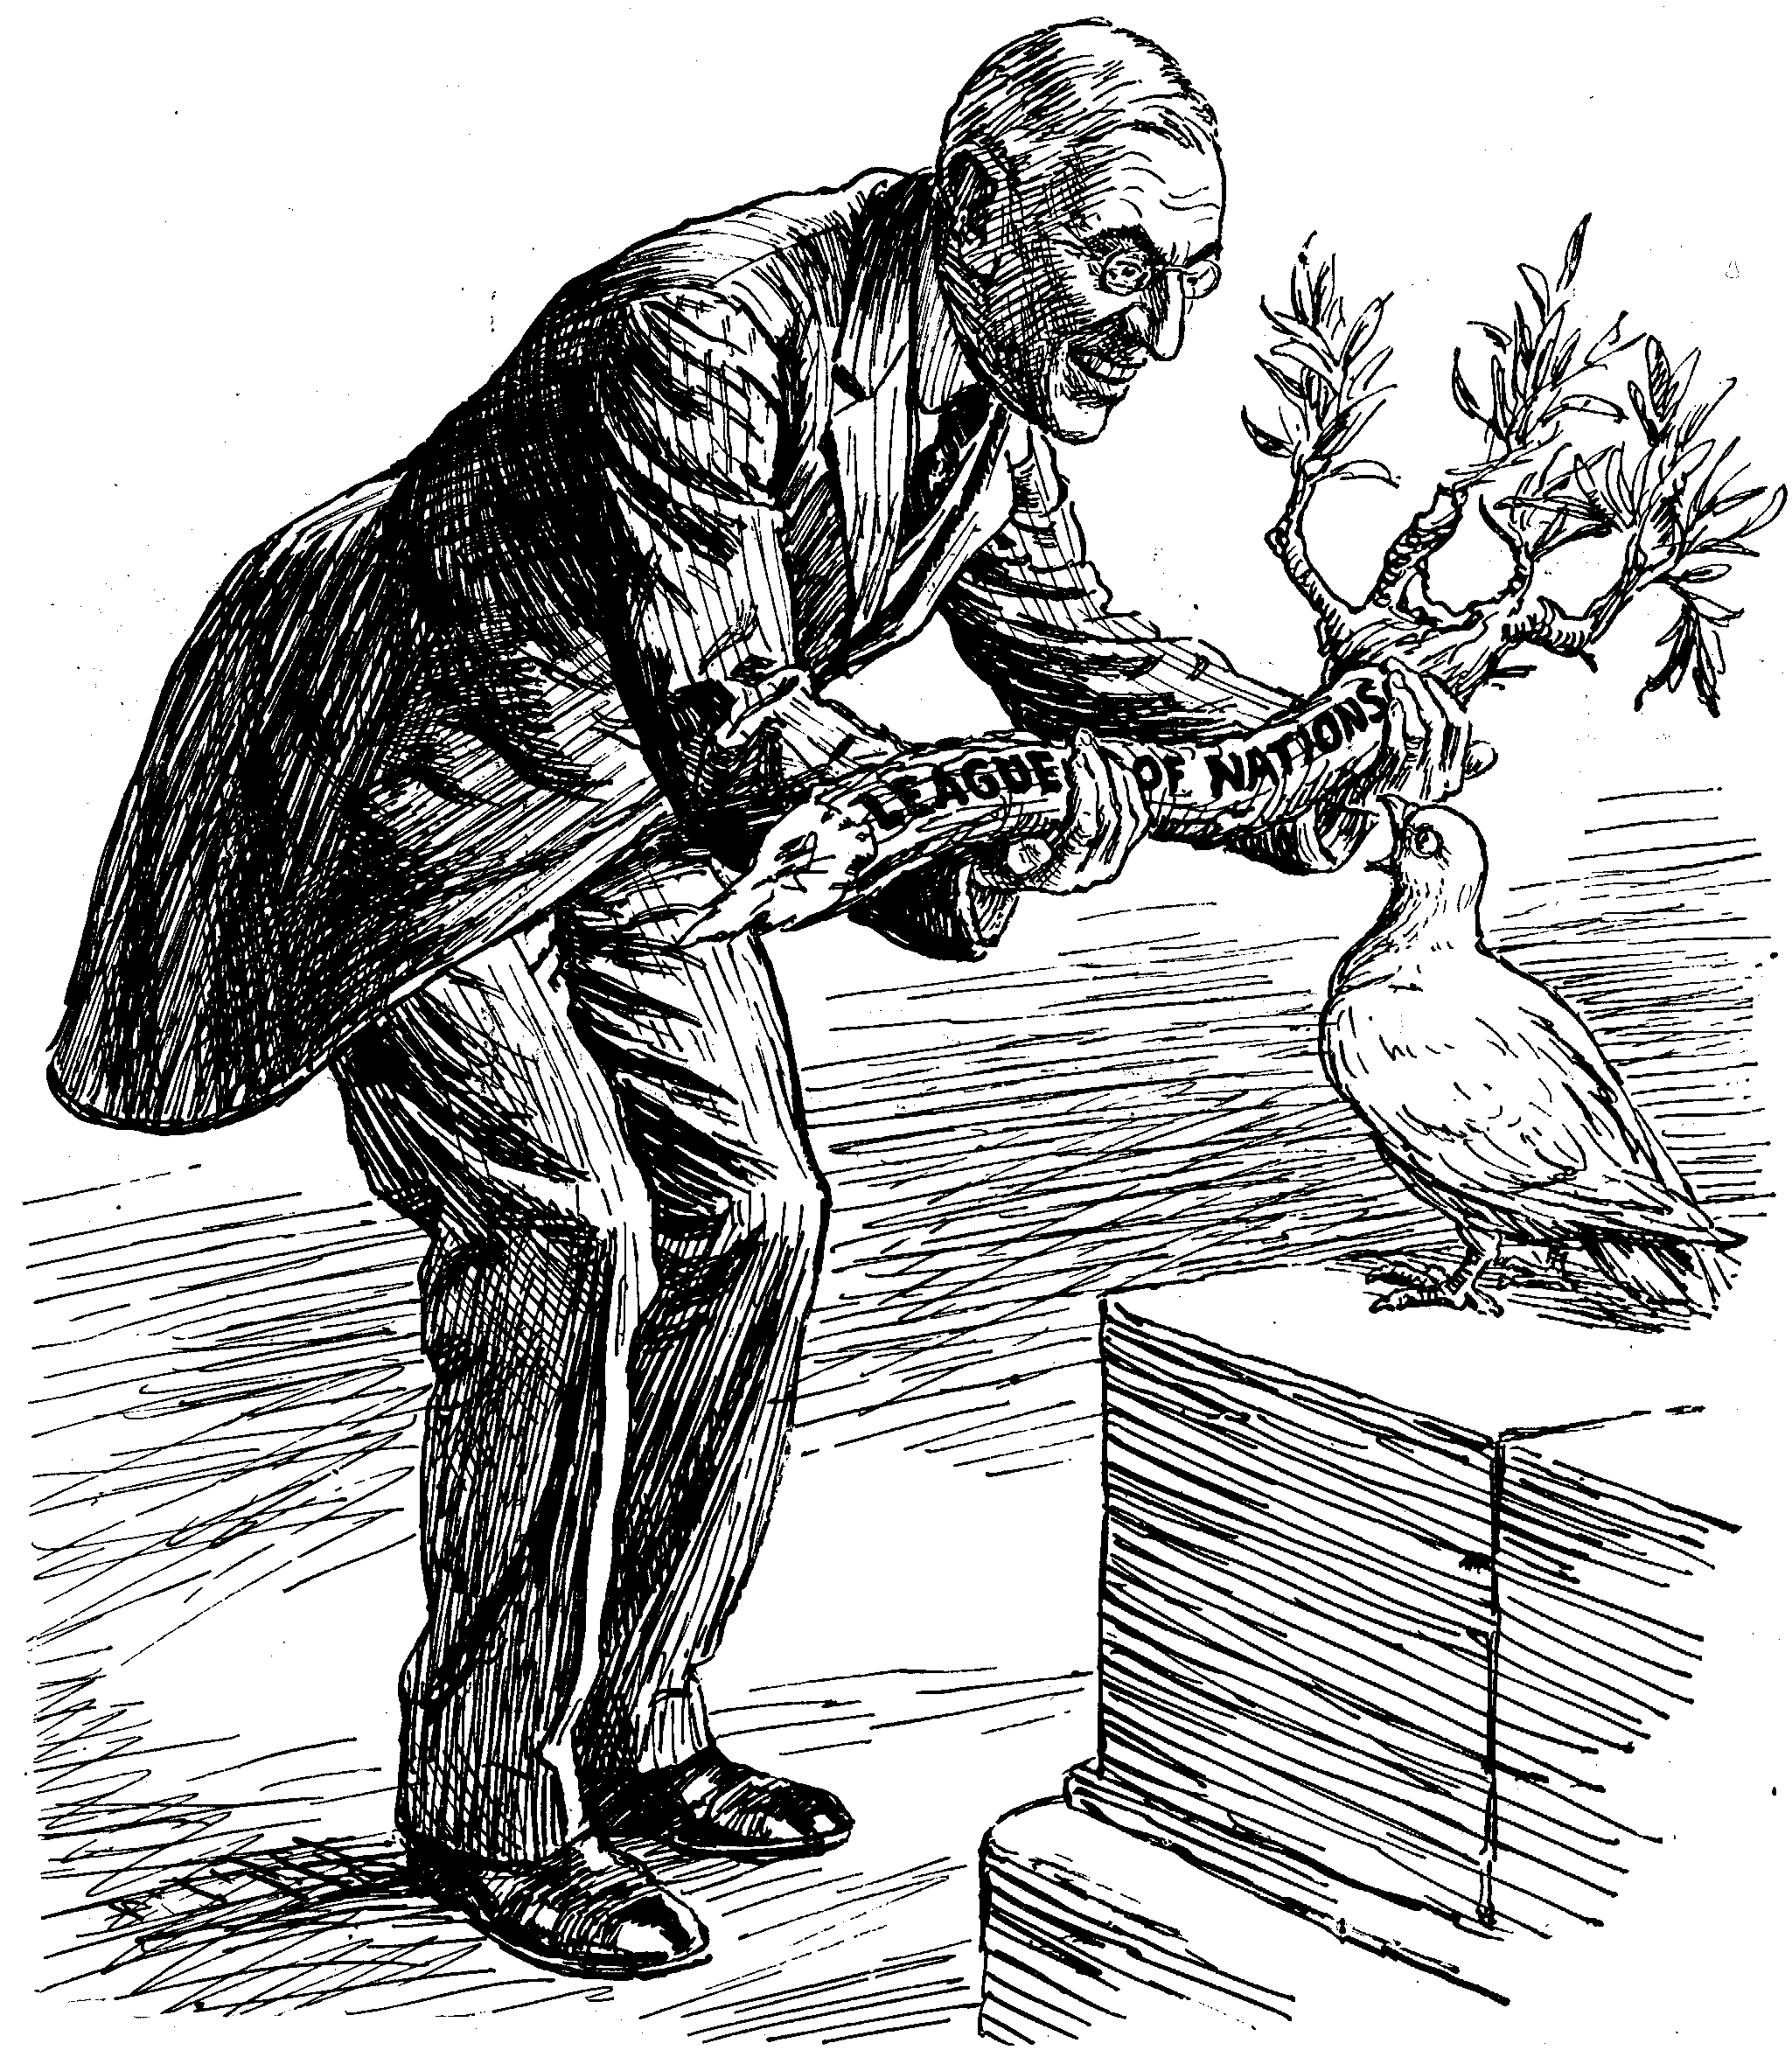
G

Slide 8
H

Slide 9
I

Slide 10
J

Slide 11
K

Slide 12
L

Slide 13
M

Slide 14
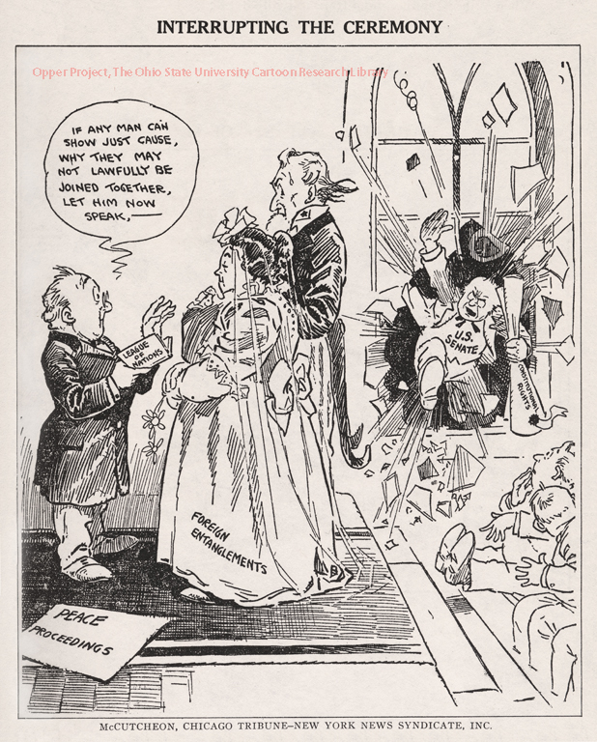
N

Slide 15
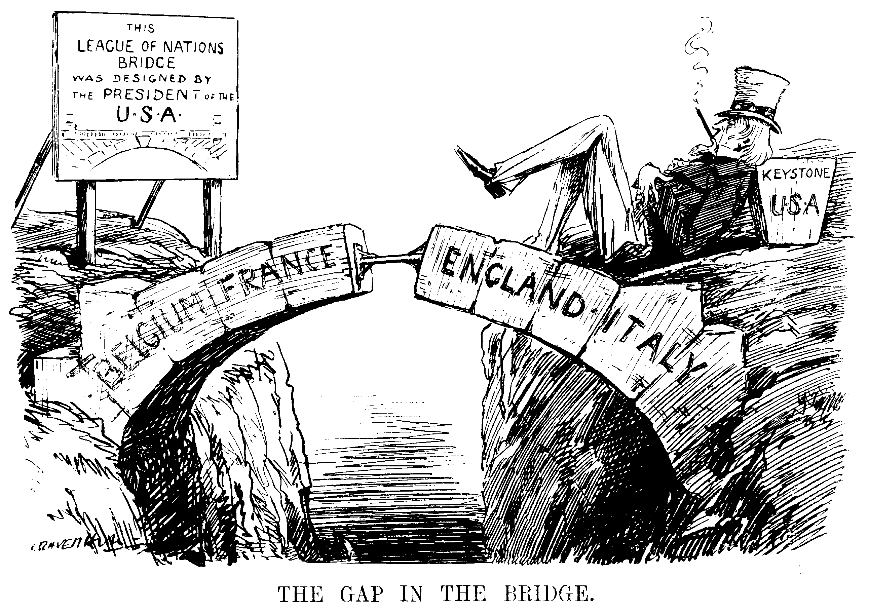
O

Slide 16
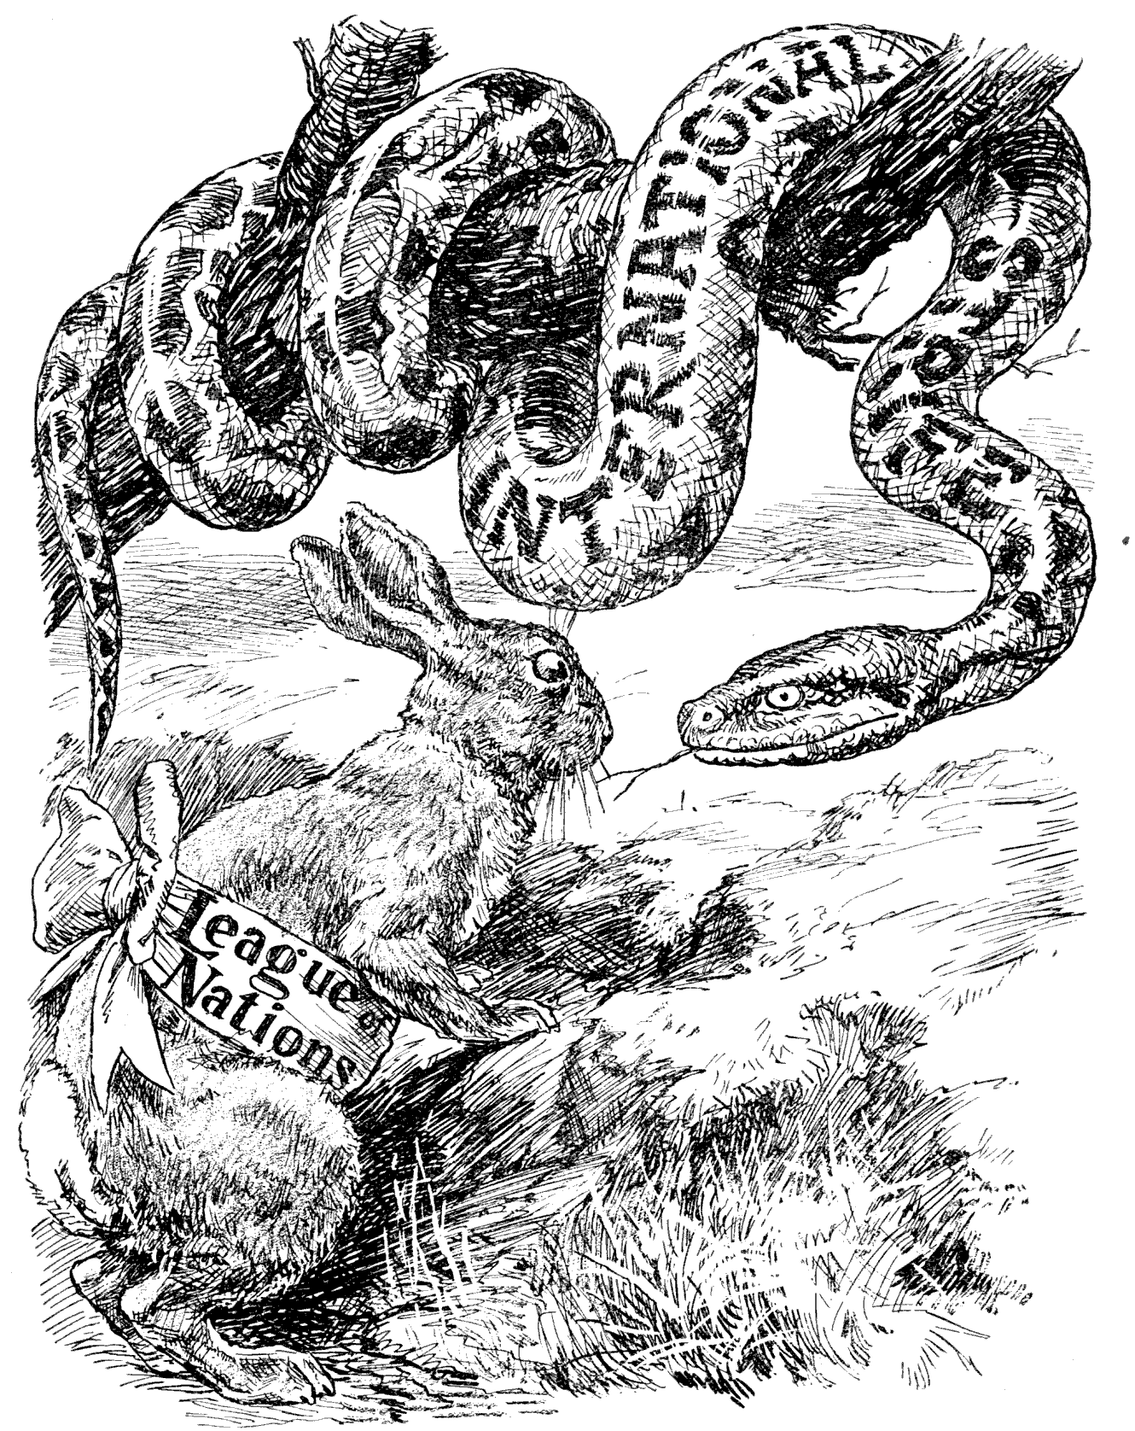
P

Slide 17
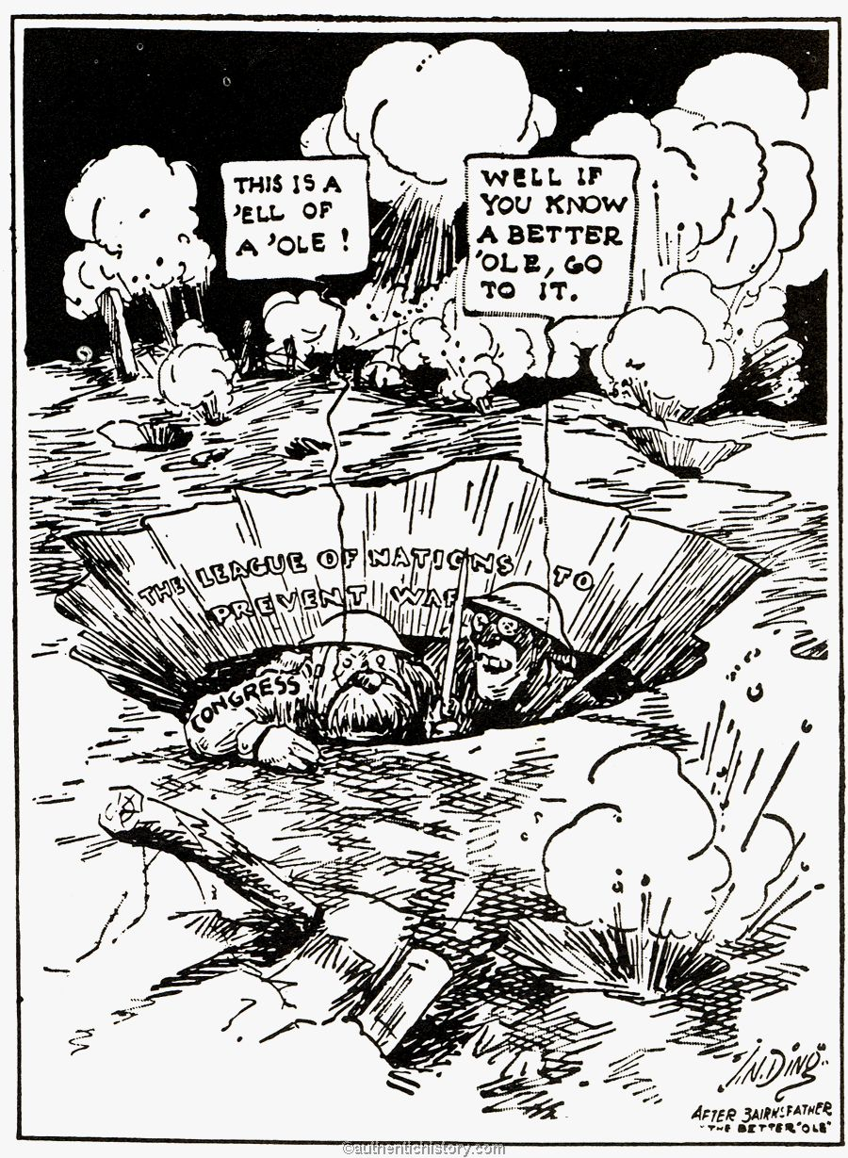
Q

Slide 18
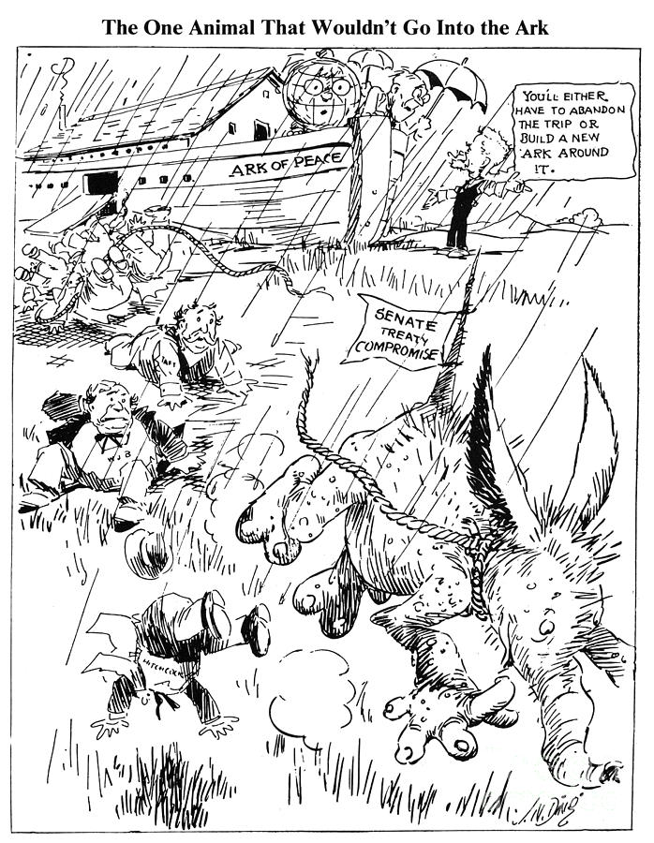
R

Slide 19
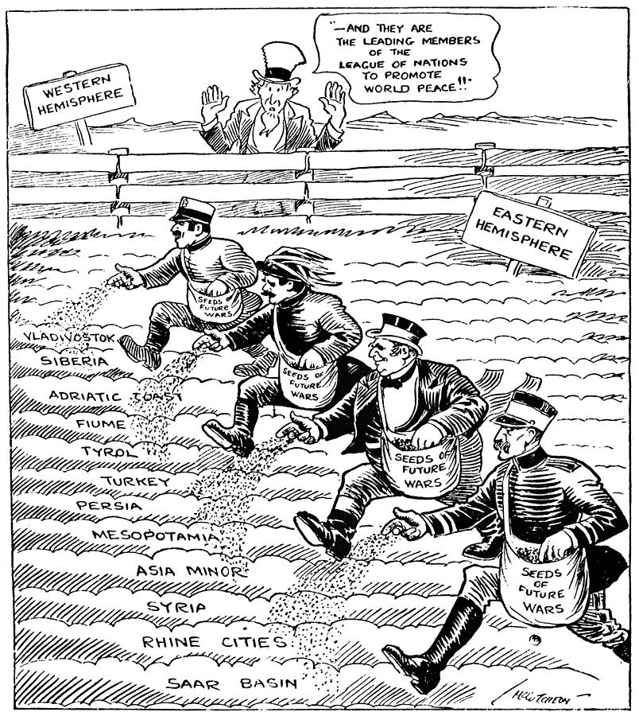
S

